Slide 1
Hey! You put pester in my Terraform!
Testing infrastructure as code

Slide 2





whoami
Brandon Olin
Staff Site Reliability Engineer @ Stack Overflow
2xMicrosoft MVP (Cloud and Datacenter Management)
@devblackops
github.com/devblackops
devblackops.io

Slide 3
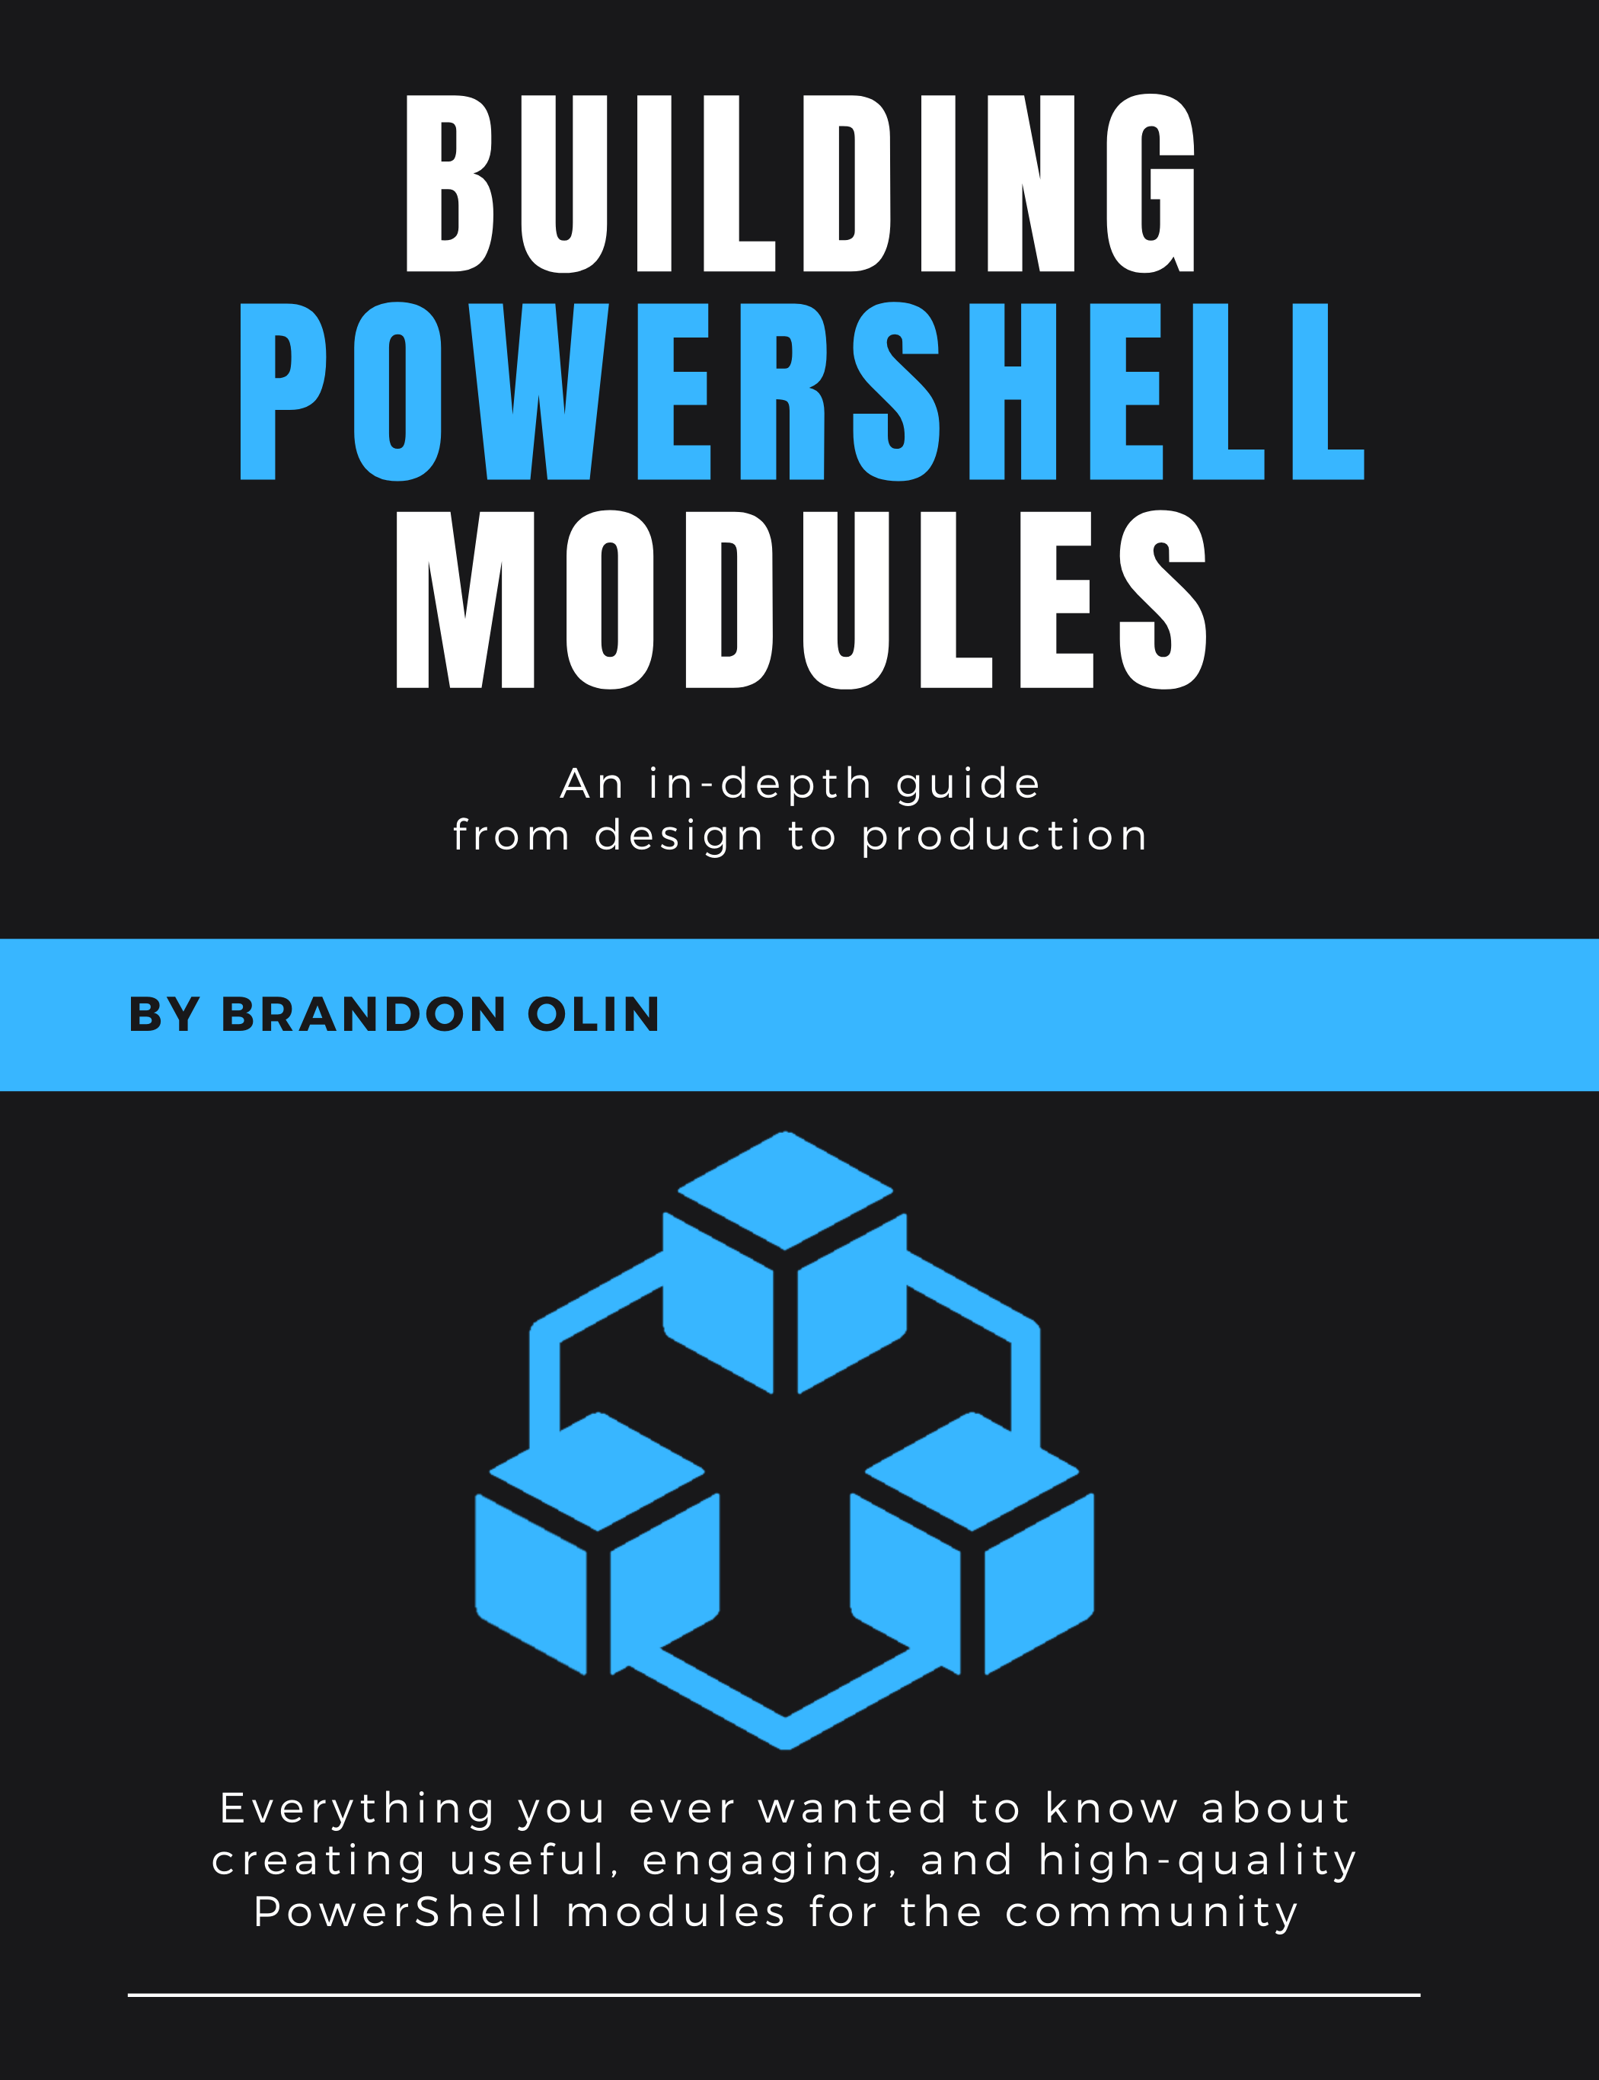
Powershell Book
Building PowerShell Modules https://leanpub.com/building-powershell-modules
An in-depth guide to creating high-quality PowerShell modules including docs, tests, CI/CD, and community engagement.

Slide 4
Agenda
What is Infrastructure as Code?
Why test it?
Unit and integration tests
Terraform 101
Testing Terraform with Pester

Slide 5
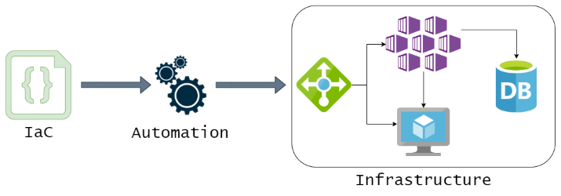
What is Infrastructure as code?
Defines what your infrastructure should look like, then executes code to “make it so.”
Reusable templates or modules to build similar infrastructure
Allows for creating complex infrastructure quickly and consistently
Treated like normal code
Should be version controlled
Should be tested
Examples
Terraform
Pulumi
ARM templates
Bicep/PSArm

Slide 6
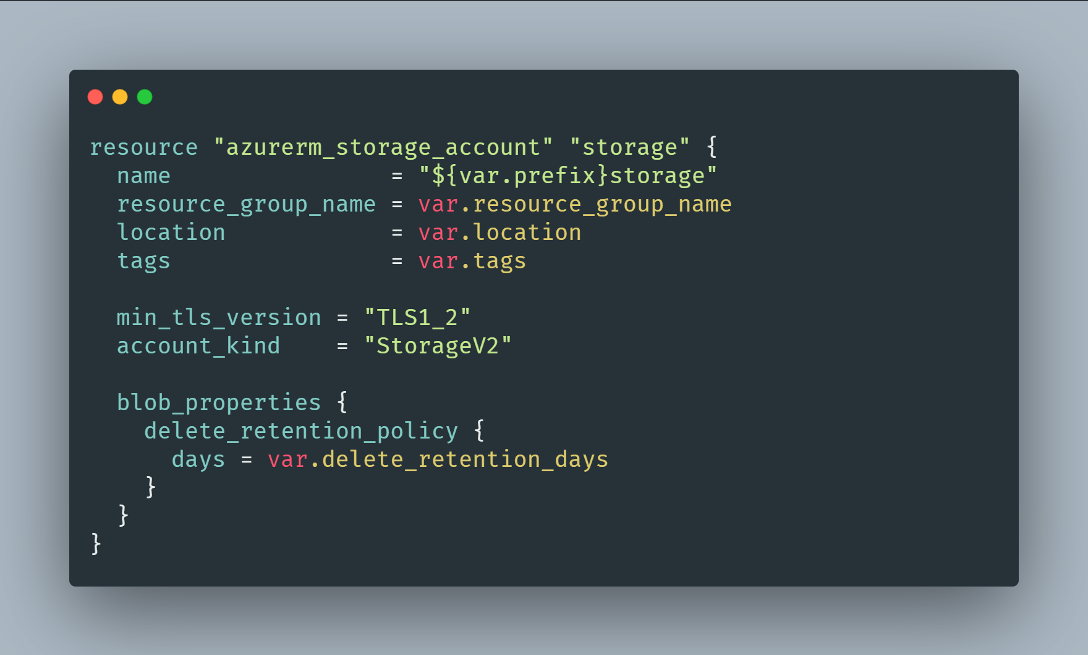
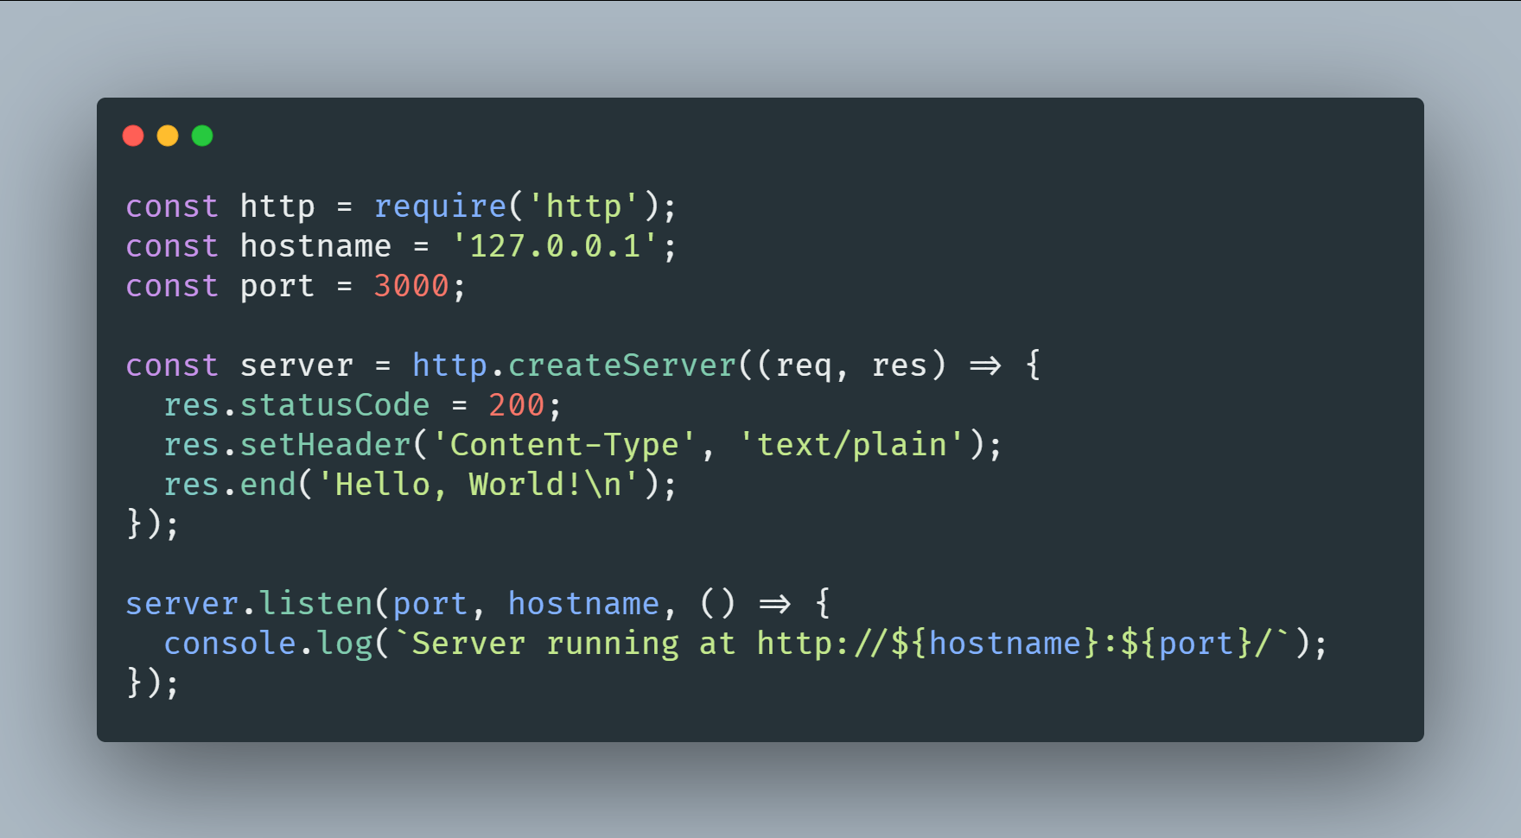
Why test your infrastructure
Are these really any different?

Slide 7
Why test your infrastructure
It’s just code! Only with more YAML/JSON/HCL
Nobody is perfect. Infrastructure as Code will have bugs
Your infrastructure will change over time
Tests are how we ensure our infrastructure is configured the way we think it is
Tests are how we ensure it stays working with things inevitably change

Slide 8
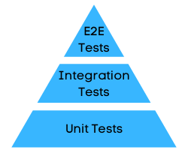
Categories of tests
Unit
Tests a component in isolation
Expected inputs yield expected outputs (2+2=4)
No not modify the environment
Limited to no dependencies
Fast to execute
Integration
Tests how components interact with each other
Can modify the environment
Have dependencies
Slower to execute
Linting
Validates code is technically correct
Tests for syntax errors
Validates against style guidelines
Answers the question: “will this code run?”
Manual
Most common for people start with
Can be tedious and inconsistent
If documented, can form the basis for automated tests in the future
Better than nothing!
* Not an exhaustive list

Slide 9






Terraform 101
Declarative code written in HashiCorp Configuration Language (HCL)
Terraform reads HCL and plans/builds infrastructure from it
Supports all major Cloud providers, and on-premises infrastructure like VMware
Healthy ecosystem of open-source providers for all types of infrastructure

Slide 10
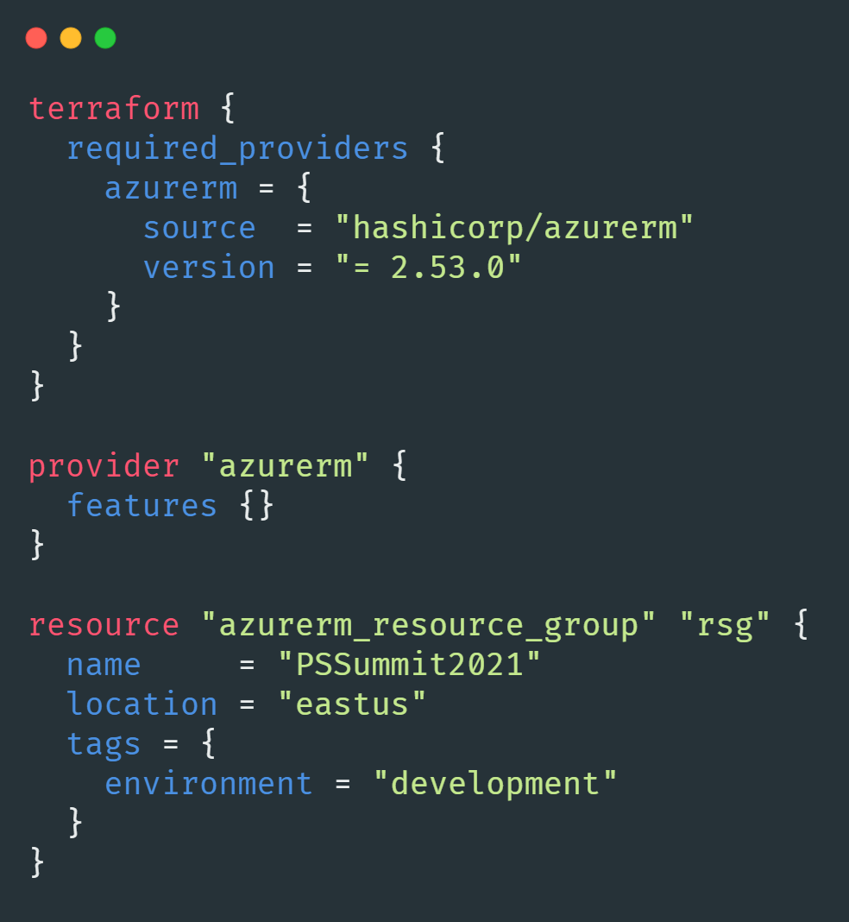
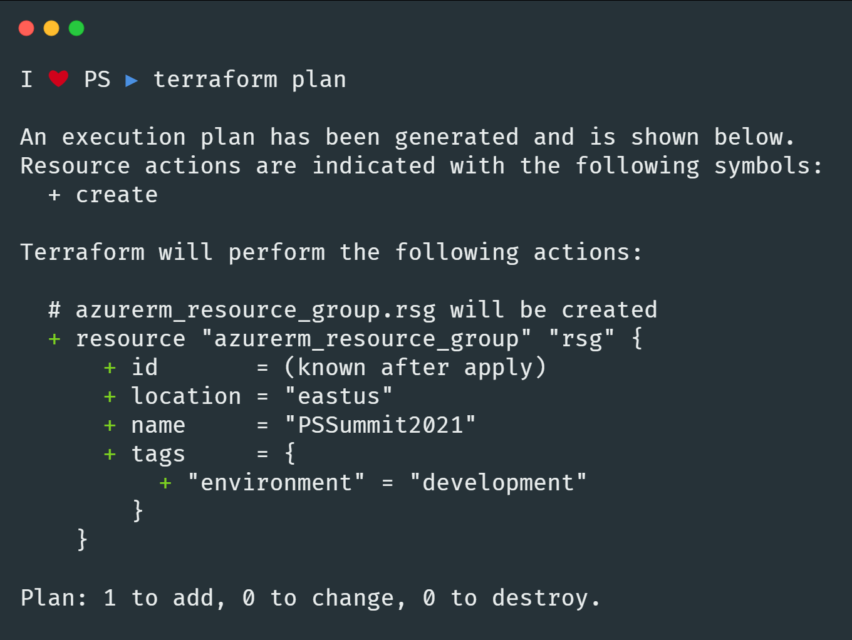
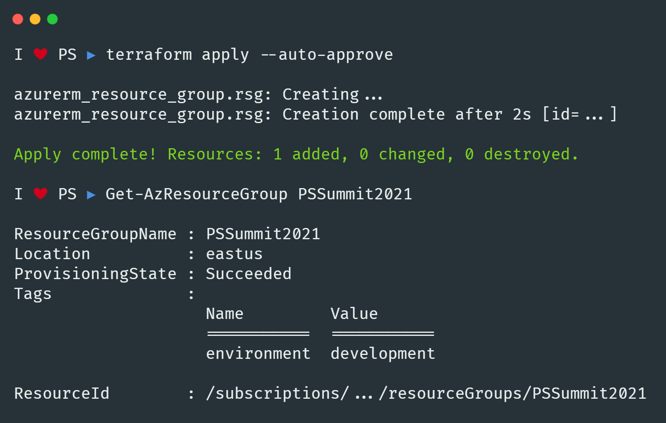
Terraform 101
Write
Plan
Apply

Slide 11
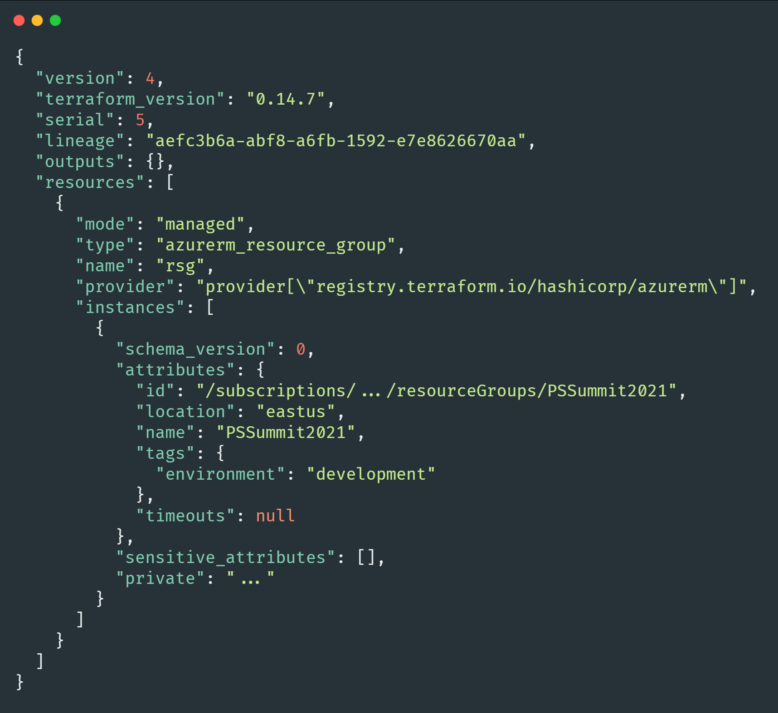
Terraform State
JSON file Terraform uses to keep track of infrastructure
Terraform compares reality to the state file to determine what to do
Critical to how Terraform works
We’ll use this with our Pester tests

Slide 12
Demo

Slide 13
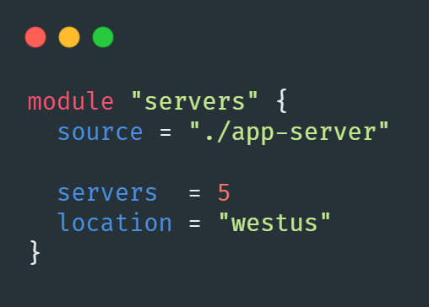
Terraform modules
Containers for multiple resources that are used together.
Used to abstract away implementation details of complex resource configurations
Primary way to package and reuse Terraform configurations
Module components
Input variables
Resource definitions
Output variables

Slide 14
Demo

Slide 15
Testing Terraform
Tests should be run in an isolated environment
Deploy ephemeral infrastructure for your tests
Handle dependencies
Use example configurations as test cases
Understand Terraform’s state file, and plan/apply cycle

Slide 16
Testing Terraform with Pester
Use example directories as Pester test cases
Contexts and tags for unit and integration tests
Unit tests
Run “terraform plan” and import the plan file to get intended changes
Run Pester tests to validate intended configuration
Integration tests
Run “terraform plan” and then “terraform apply” to deploy the example configuration
Import plan and state files
Get deployed resources from Azure
Run Pester tests to validate deployed configuration

Slide 17
Demo

Slide 18
Summary
Infrastructure as Code needs to be tested, just like normal code
Use unit tests for fast validation of intended configuration
Use integration tests for more involved scenarios
Extending the practice:
Integration IaC tests into a CI/CD pipeline
Use tests to enforce policy and standards
Run them on all PRs and merges to main
Catch errors before applying to production infrastructure

Slide 19
Thank you
Brandon Olin
Staff Site Reliability Engineer @ Stack Overflow
@devblackops
github.com/devblackops
devblackops.io
Building PowerShell Modules https://leanpub.com/building-powershell-modules

